Slide 1
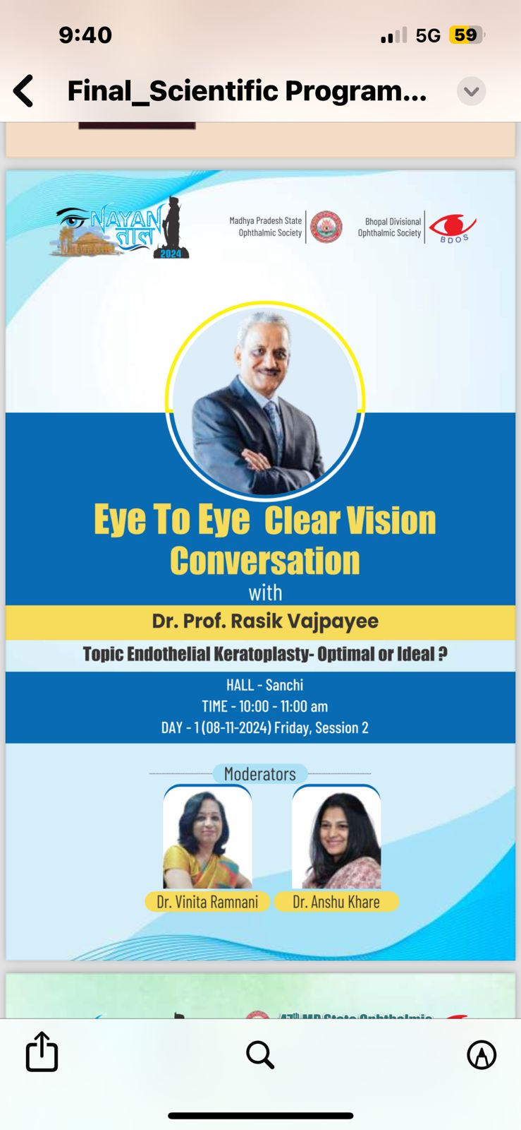

Slide 2
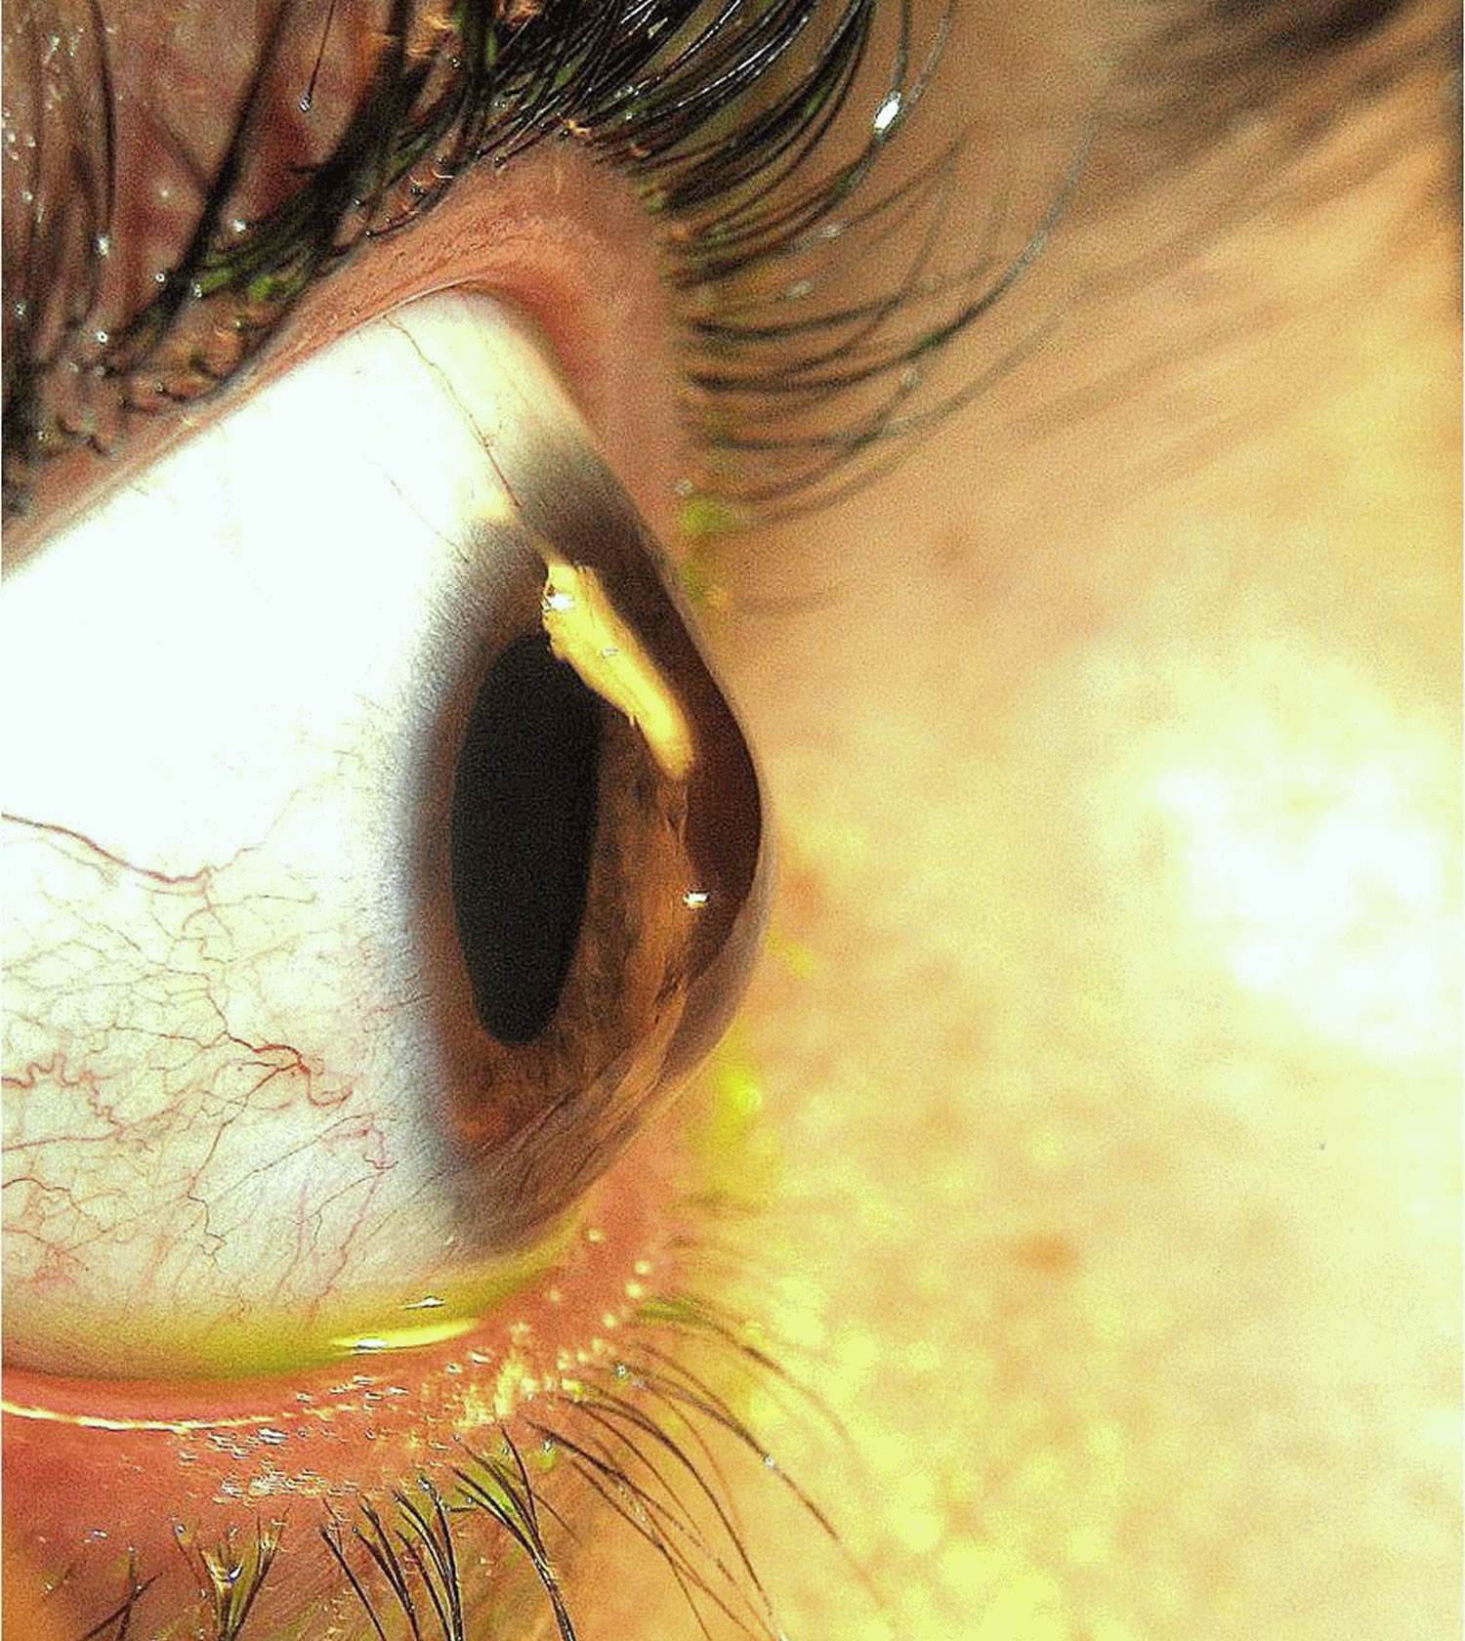
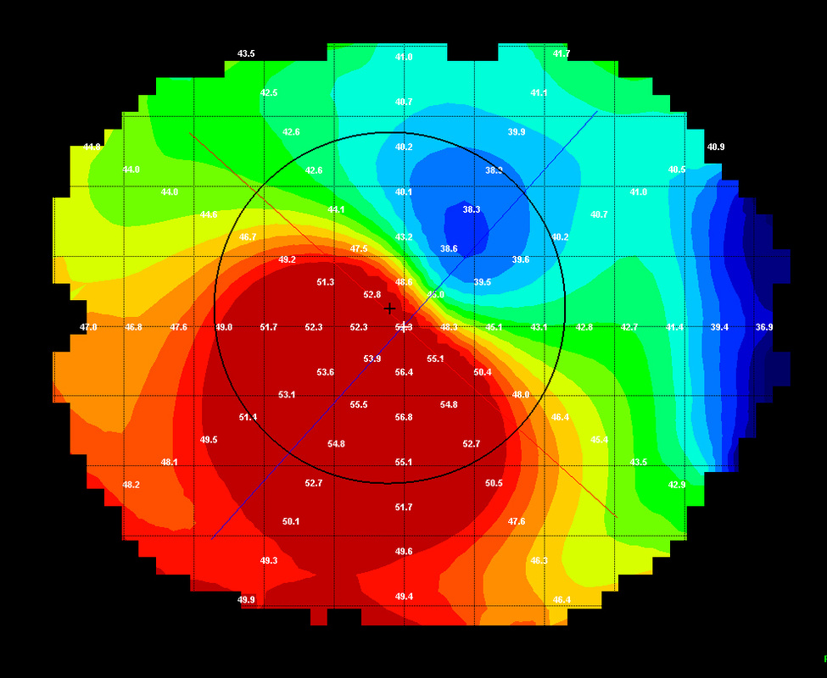
(1) Walk in keratoconus patient
How to proceed for the various treatment modalities
When will you plan for CXL in K-conus
When can contact lens trial be given after CXL
Take on Re-CXL

Slide 3
Walk in keratoconus patient
What is your opinion on the Topo guided PRK?
Will you opt for Phakic Intraocular Lenses (IOLs) In case of keratoconus

Slide 4
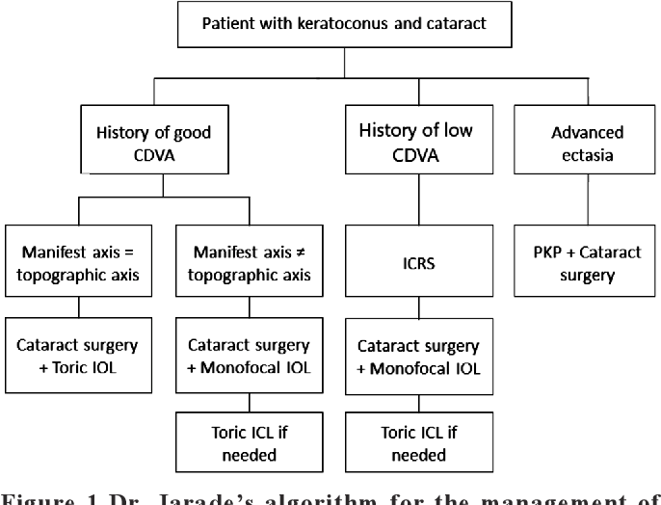
CATARACT + KERATOCONUS
Accurate Keratometry – what methods??
Preoperative need to stabilise keratometry
RGP contact lenses to be withheld for how many days
Any role of collagen cross linking or intra stromal corneal ring segments
Choice of IOL :Monofocal vs toric vs extended depth
PINHOLE IOL FOR K-CONUS
Dr. Jarade’s algorithm for the management of keratoconic eyes with cataract

Slide 5
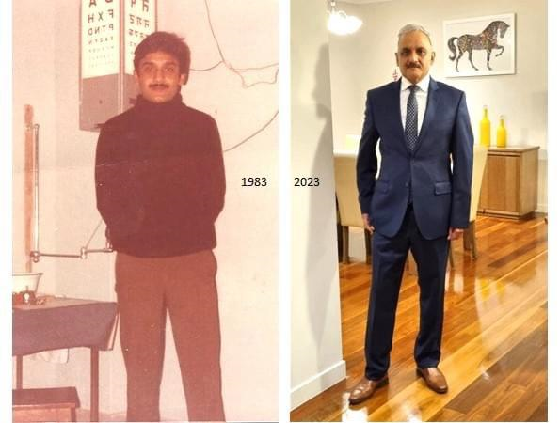
(A) Dr Rasik was in INDIA and Dr Rasik In Australia
What major change you have felt as a person
What Difference you felt in Ophthalmology at both places

Slide 6
Training abroad if some one interested how can you be a catalyst in igniting the zeal of research ?

Slide 7
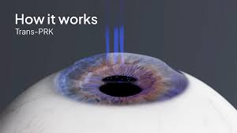
(2) LASIK VS TRANS PRK
Today the trans PRK is becoming very popular owing to its ease of doing and very short learning cure .
What opinion do you have compared to the other refractive procedures.

Slide 8
In which cases you will choose trans PRK over LASIK ?
In how many cases do you observe postoperative corneal haze and what is the maximum time period in your experience for which this haze is observed ?

Slide 9
Lamellar keratoplasty
What factors influence the success rate of Endothelial keratoplasty?
DMEK/DSAEK ?
How long it takes for visual recovery in case of DSEK/DMEK and what is the post op refractive change?
For combined cataract and endothelial keratoplasty –DSEK/ DMEK?
What are the chances of graft rejection in Endothelial Keratoplasty?

Slide 10
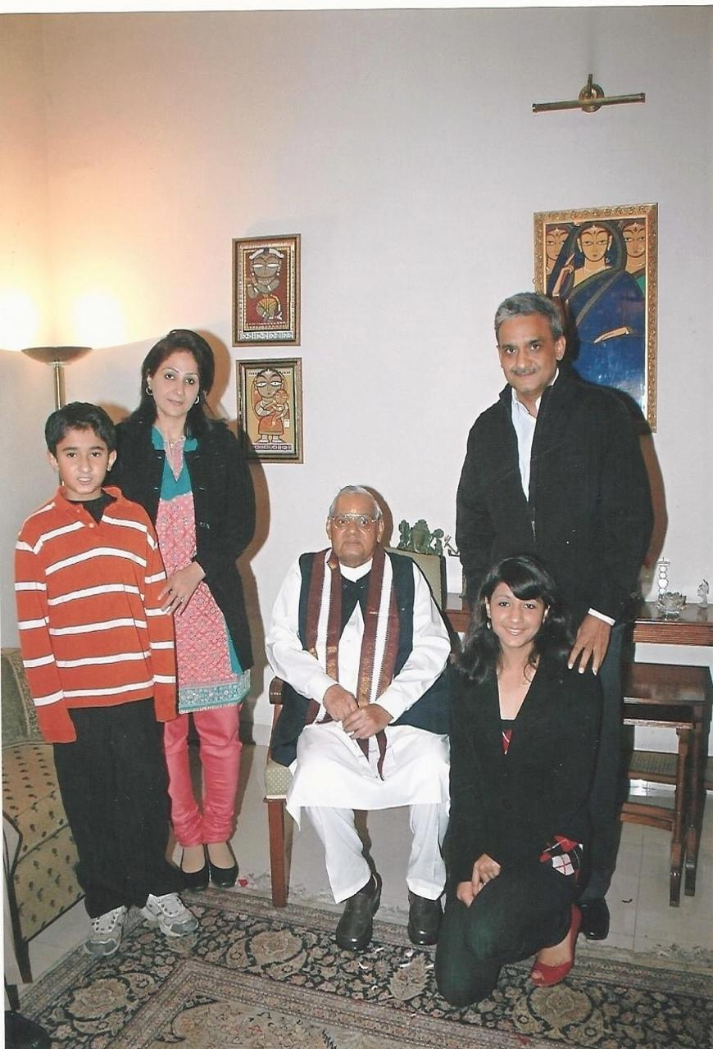
(B) Dr Vajpayee to Shri AB Vajpayee Jee
Please Share your experience with Shri Atal Bihari Vajpayee Jee ?
Is there anything that inspired you the most from his life?

Slide 11
Your memorable day in India
What is the most important thing that you miss in Australia?

Slide 12
(3) What could be the reasons for corneal ectasia post keratoplasty in keratoconus cases?
Progression of corneal thinning in the host periphery
Genetics
Inflammatory process?

Slide 13
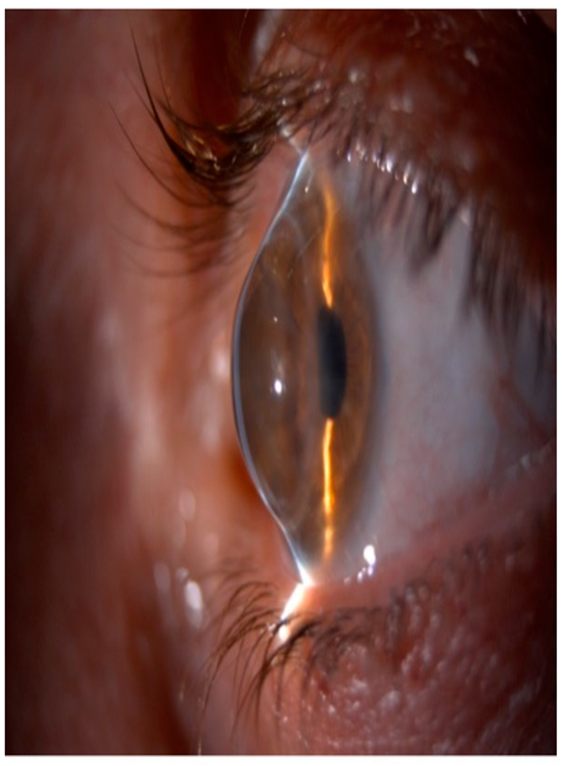
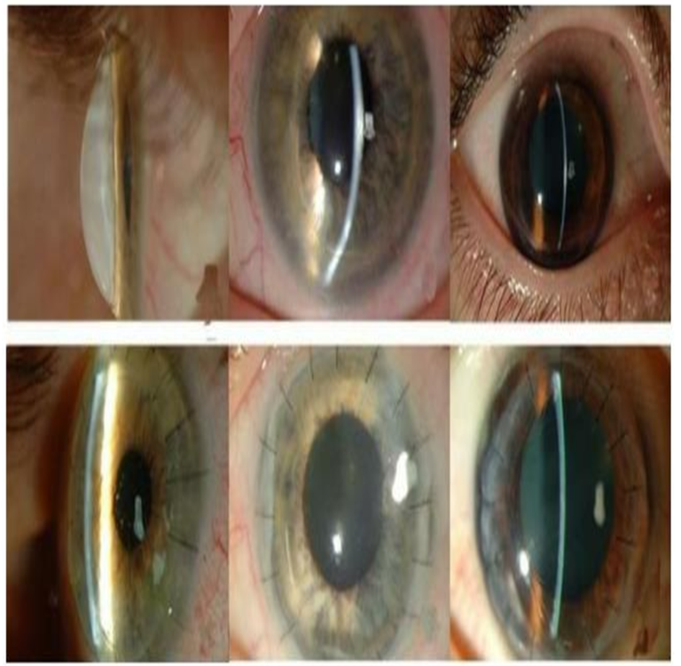
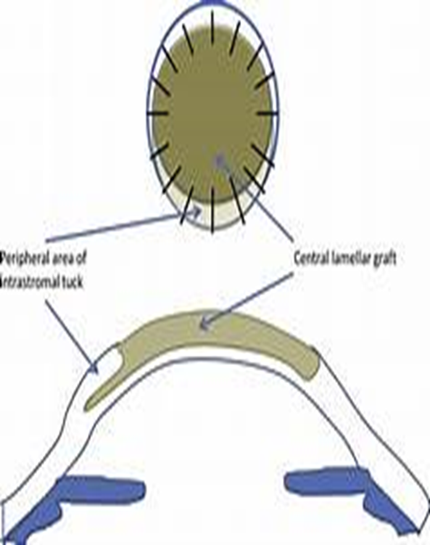
Tuck in’ lamellar keratoplasty (TILK)

Slide 14
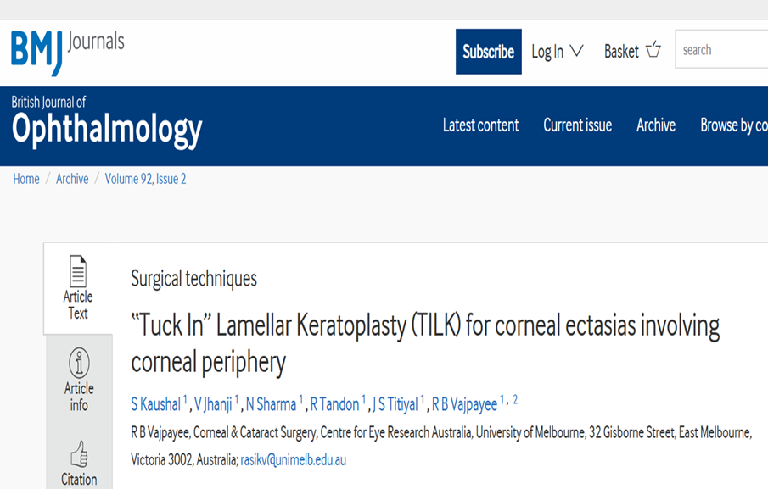
Indications for Tuck in’ lamellar keratoplasty (TILK)
What is the advantage of tuck-in lamellar keratoplasty over the conventional K-plasty?
How it is done?? (procedure)

Slide 15
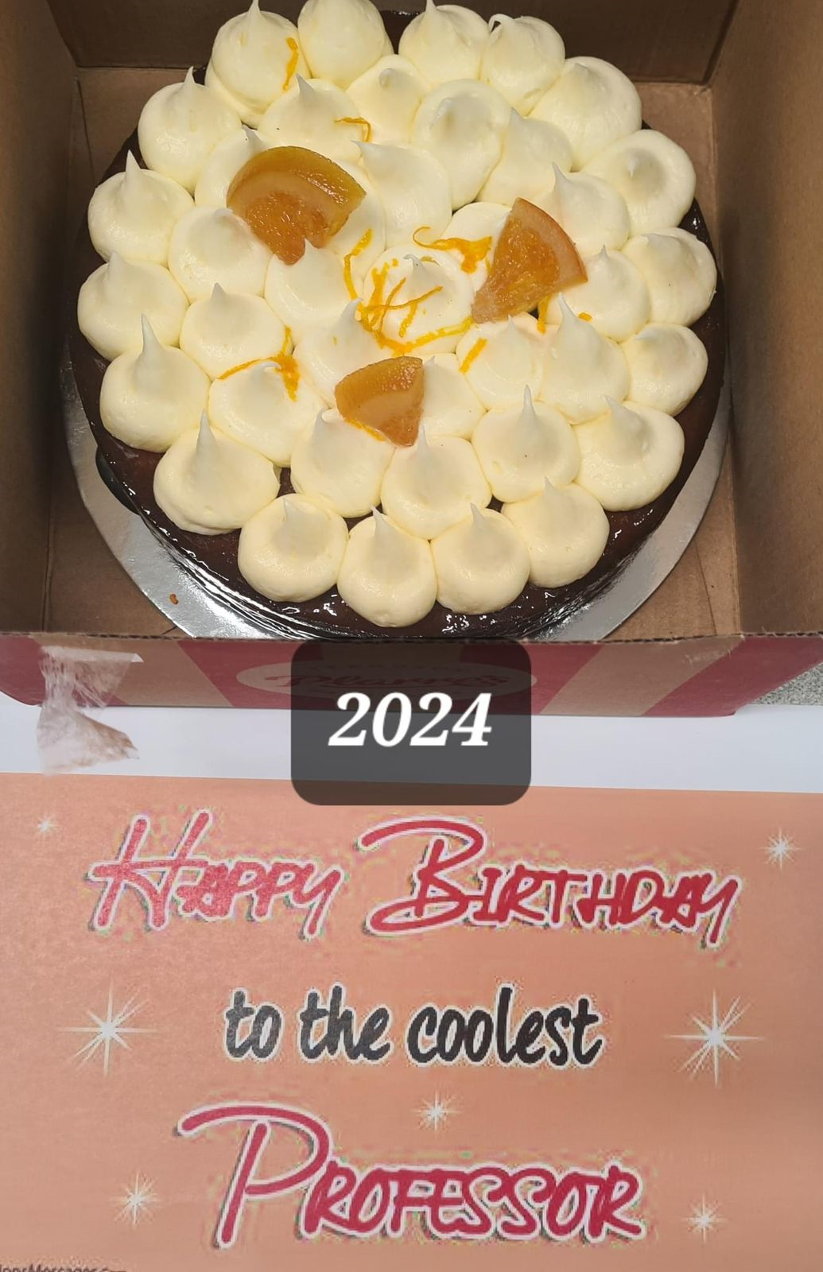
(c) Dr Rasik as Coolest Professor- How

Slide 16
What is this 80-20 mantra

Slide 17
(4) Cataract post LASIK

Slide 18
Cataract post LASIK
What will be the preferred method for biometry and which IOL formula is best in your practise?
Which equipment do you use in your practice for accurate calculations of biometry?
What will be your guru mantra for perfect emmetropia prediction.

Slide 19
What is the appropriate time for refraction after cataract surgery in these patients?
How will you manage the refractive surprises?-

Slide 20
(d) POST GRADUATES
What should be the must things every PG should do and learn during there PGs tenure
What after PG ?? Pandora box Confused Mentor

Slide 21
Teaching and Research in INDIA – Suggestions ??

Slide 22
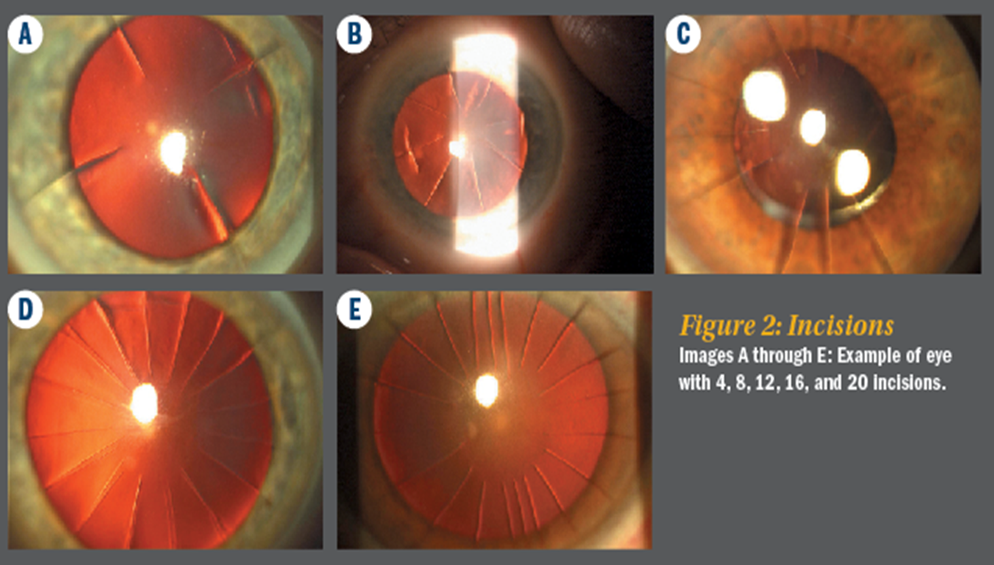
(5) CATARACT POST REFRACTIVE SURGERY

Slide 23
ON | SCENARIO I | SCENARIO I I | SCENARIO III
No. of cuts | 8 | 12 | 16
Corneal astigmatism | <1D | 2 D | 4 D
Central clear zone | 4MM | 3MM | <3MM
Adjustment of IOL Power | ? | ? | ?
Choice of IOL | MONOFOCAL/MULTIFOCAL/ EDOFF | MONOFOCAL/MULTIFOCAL/ TORIC/MULTIFOCAL TORIC/EDOFF | MONOFOCAL/MULTIFOCAL/TORIC/MULTIFOCAL TORIC/EDOFF
Incision site ON AXIS/ TEMPORAL? WITH/WITHOUT SUTURE? | ? | ? | ?

Slide 24
Accurate Keratometric readings
There is a diurnal variation in the refraction and keratometric reading in RK Case . What will be ideal time for keratometric measurement in these patients to achieve target refraction.
For corneal power and astigmatism measurement which is preferred method?

Slide 25
Accurate IOL power calculation
There is proportional flattening of anterior and posterior surface of the cornea with gradual hyperopic shift, what will you target …emmetropia or myopia ?
What adjustments will you do to the IOL power and what IOL formula works best for you?

Slide 26
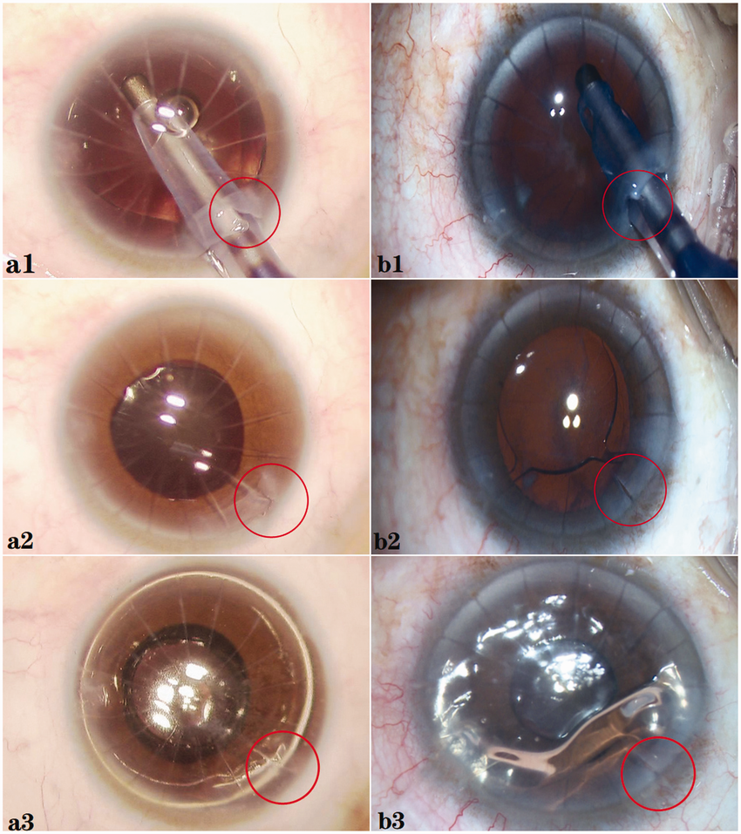
Complications-
If an RK incision is disturbed/flayed during surgery, what methods do you use to repair it .
What precautions to be taken during cataract surgery to prevent this complication?

Slide 27
(e) Artificial Intelligence boon or bane? Your opinion

Slide 28
What Exactly is meaning of this
One life lesson you want to give to all sitting here

